Slide 1
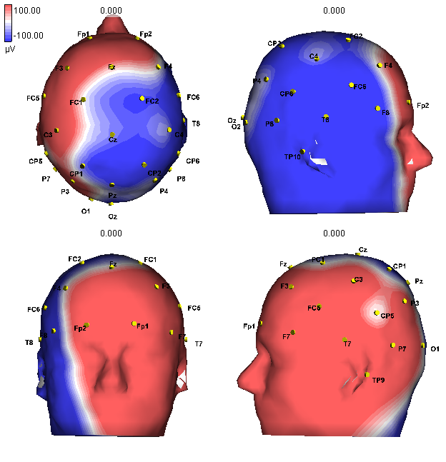
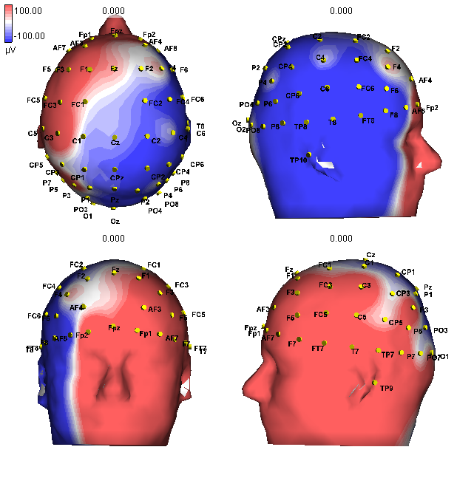
Patient 1, Spike1

Slide 2
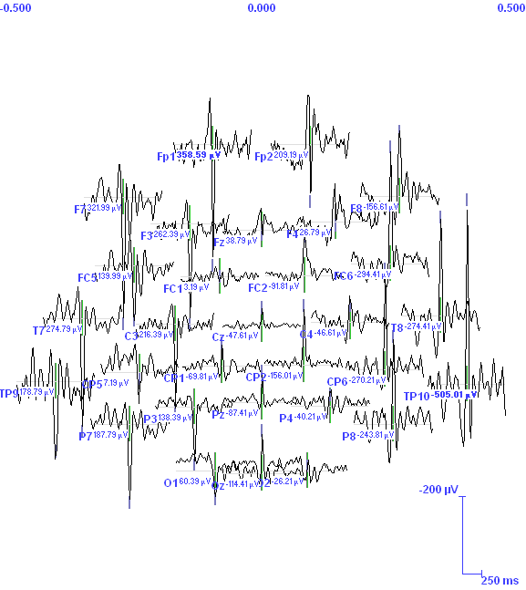
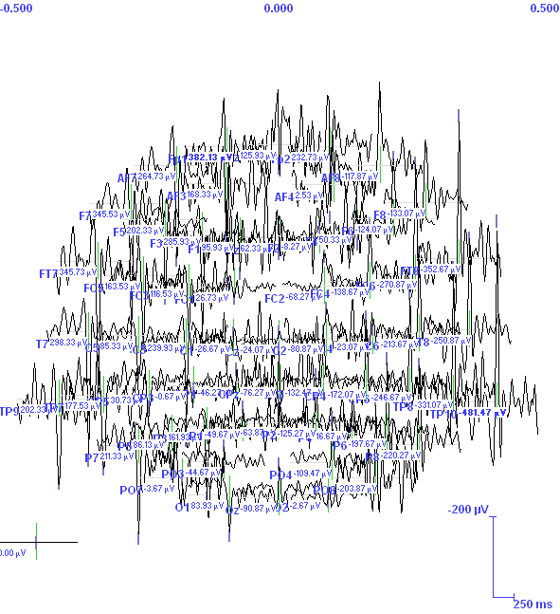

Slide 3
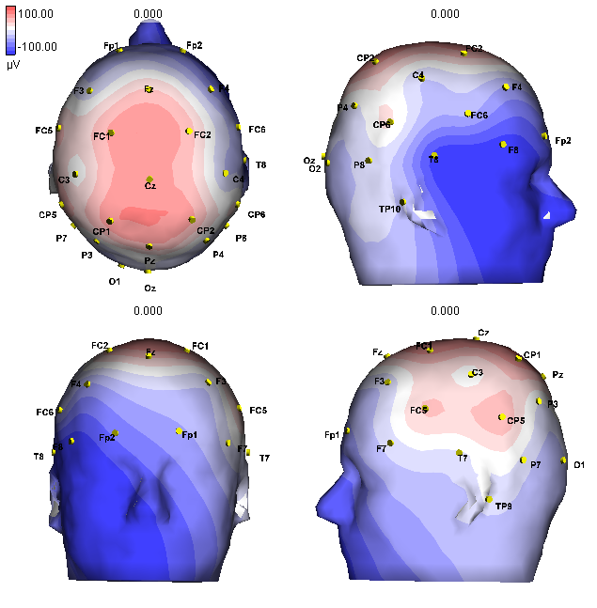
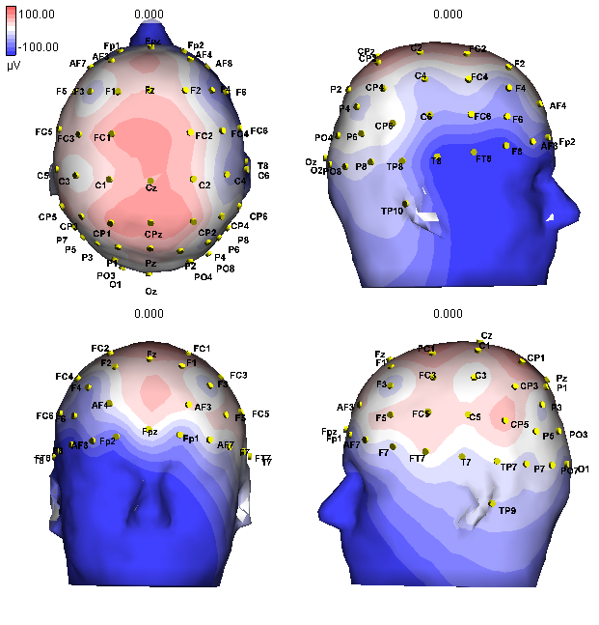
Patient 1, Spike2

Slide 4
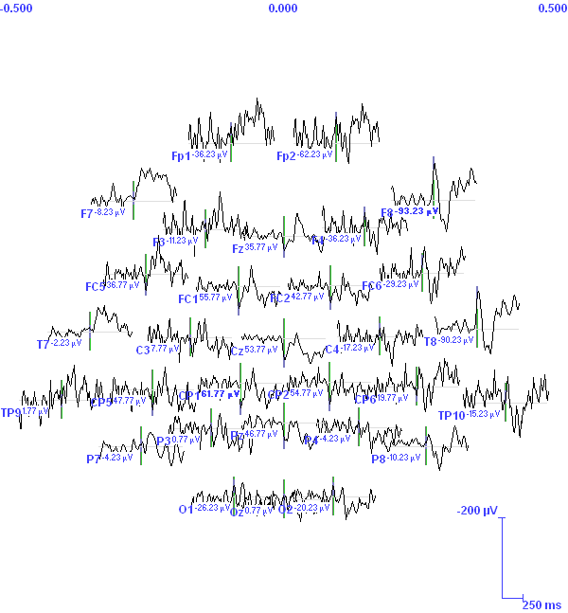
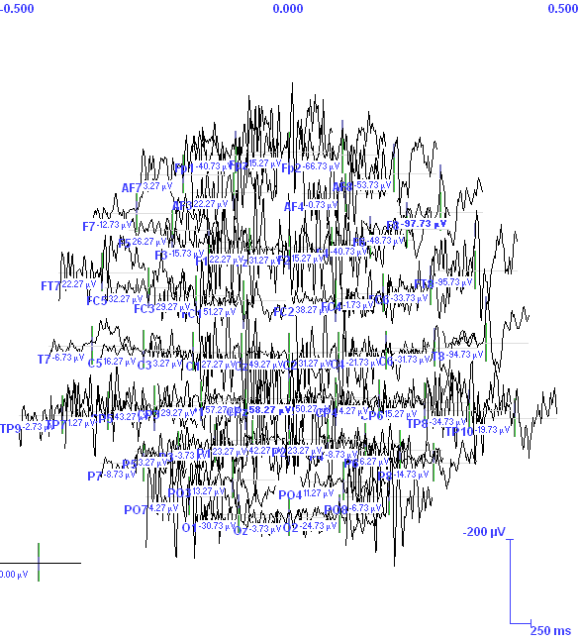

Slide 5
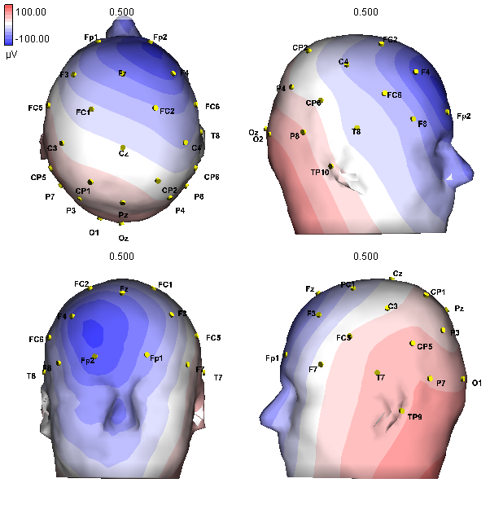
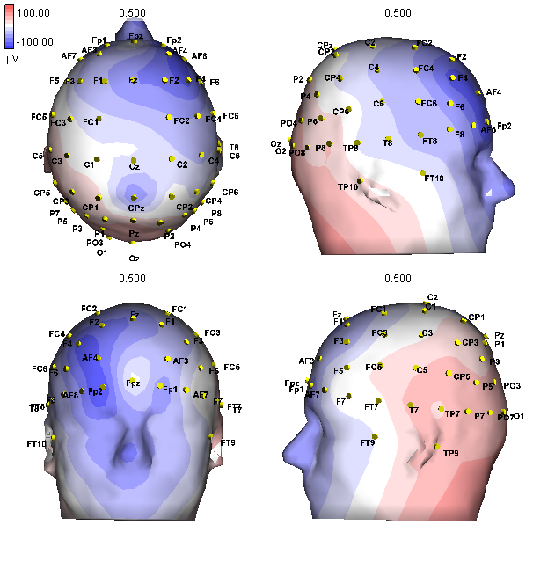
Patient 2, Spike 1

Slide 6
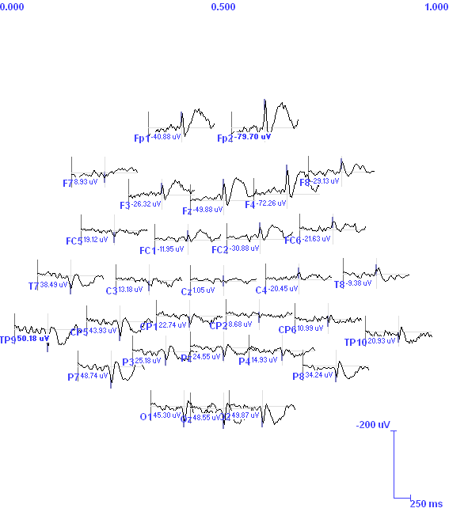
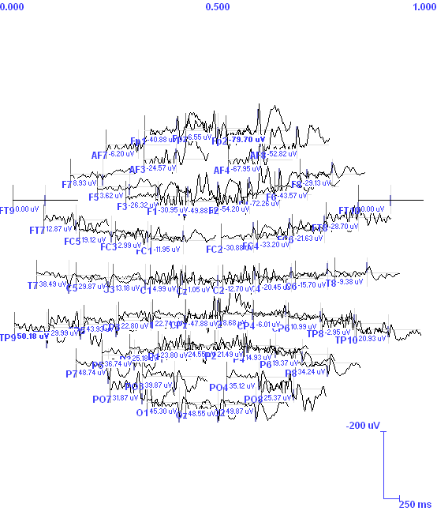

Slide 7
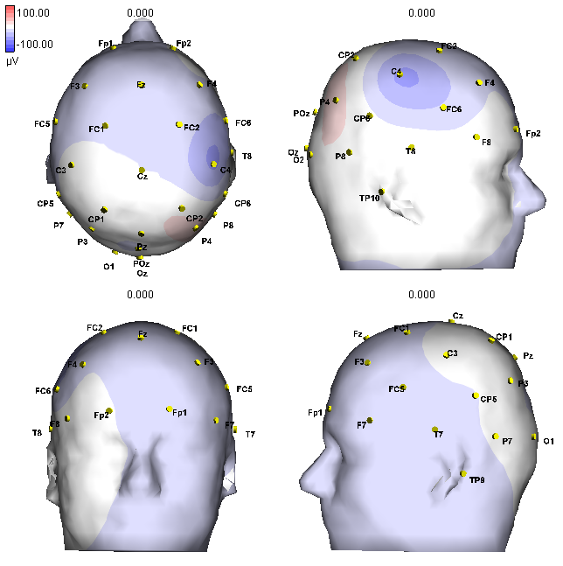
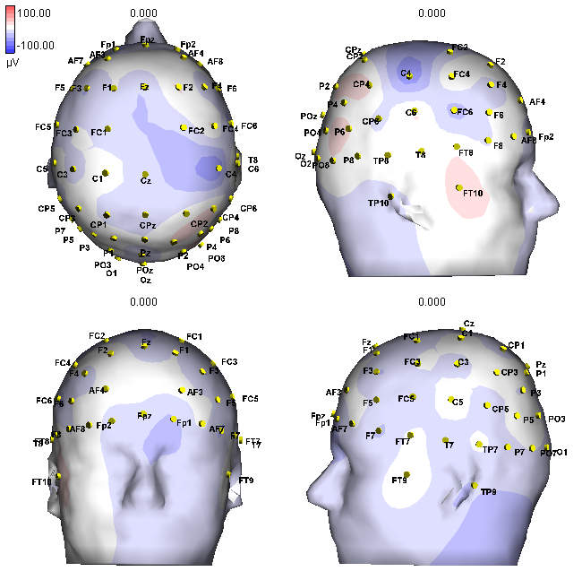
Patient 3, Spike 1

Slide 8
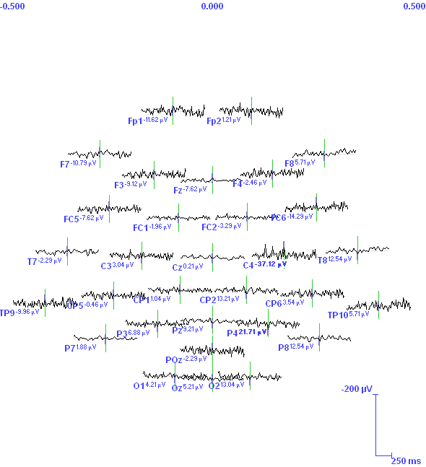
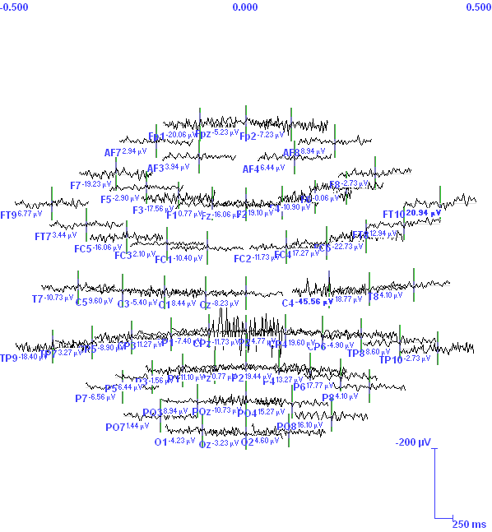

Slide 9
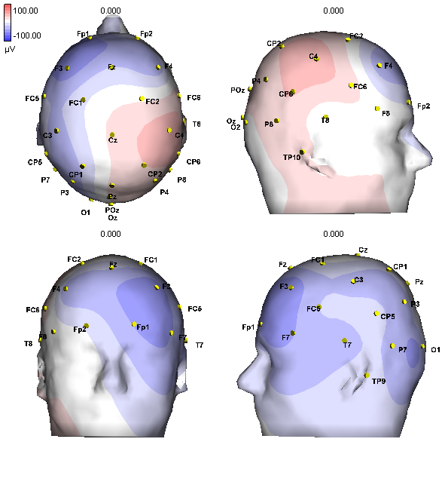
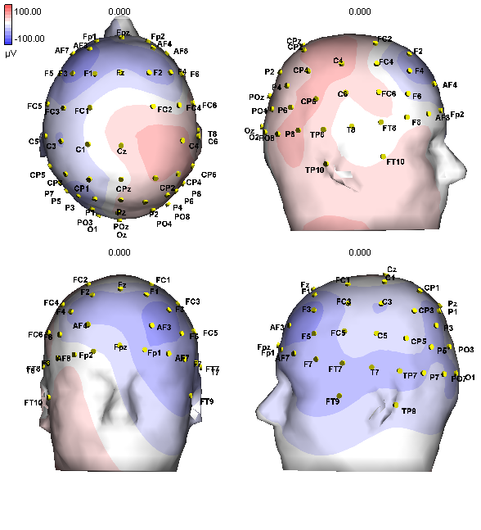
Patient 3, Spike 2

Slide 10
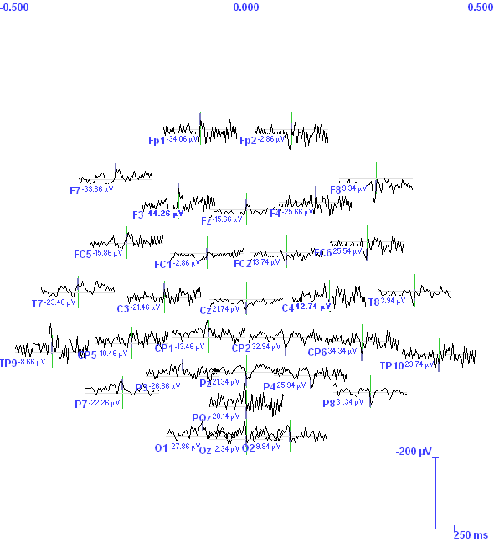
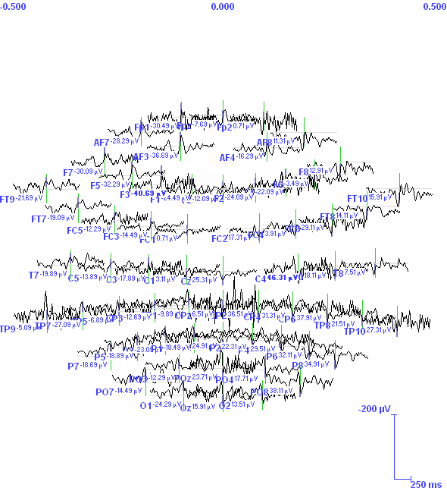

Slide 11
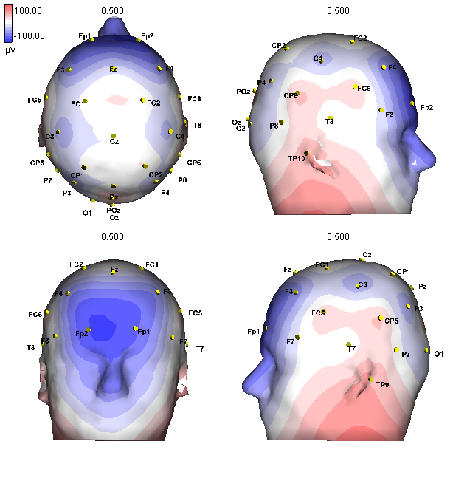
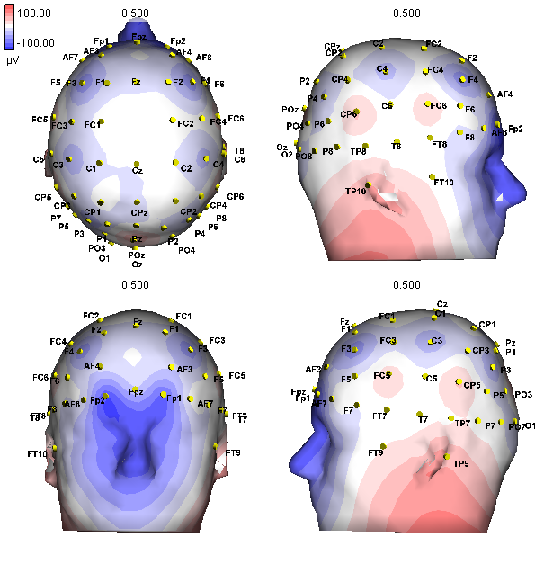
Patient 4, Spike 1

Slide 12
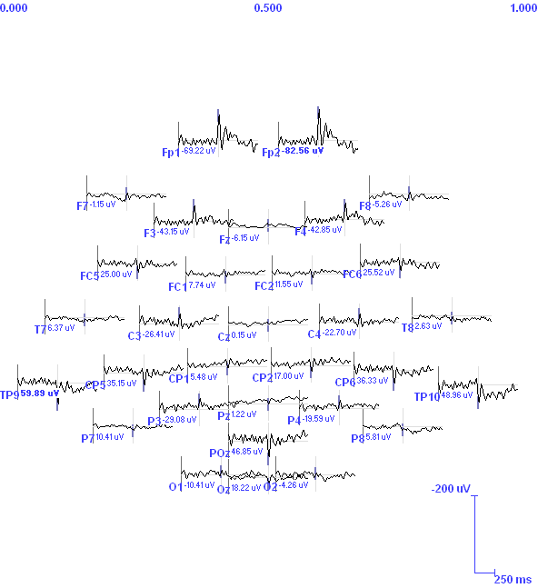
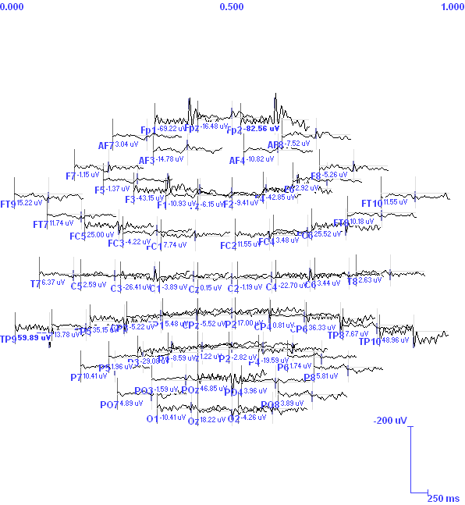

Slide 13
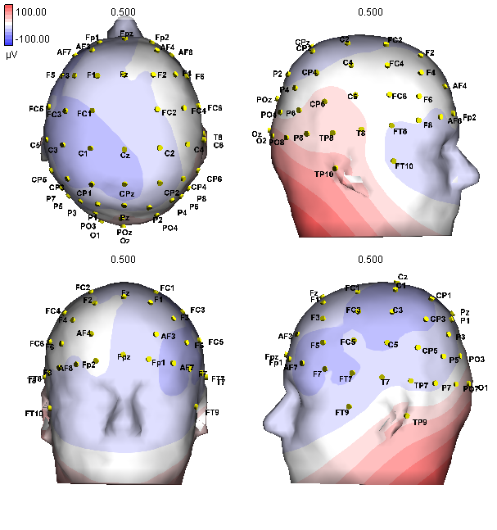
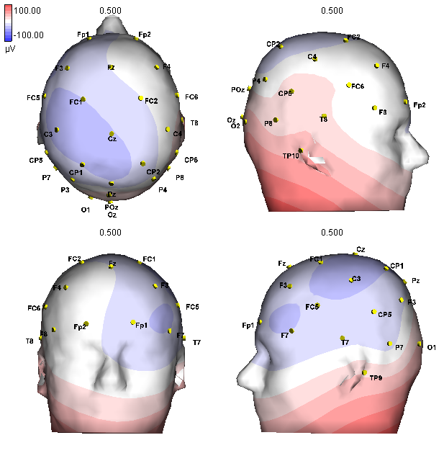
Patient 4, Spike2

Slide 14
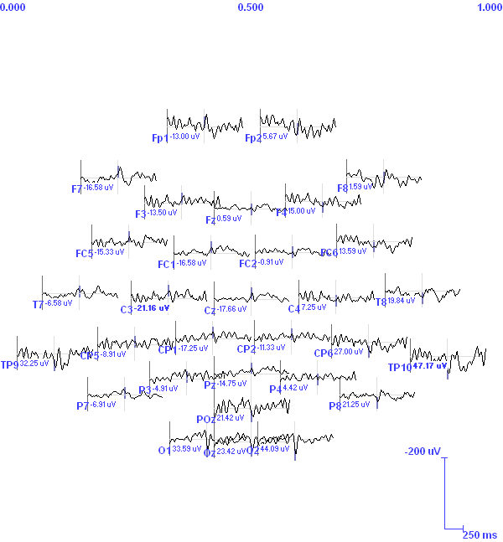
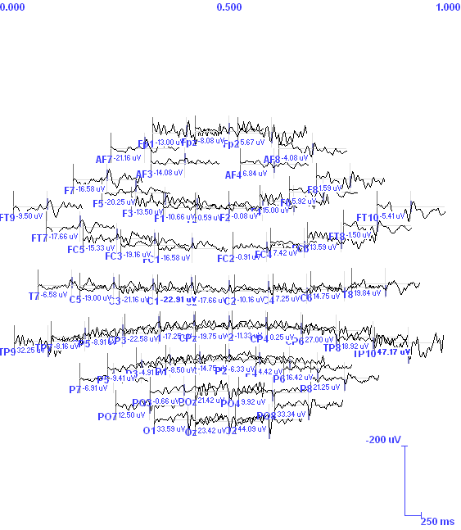

Slide 15
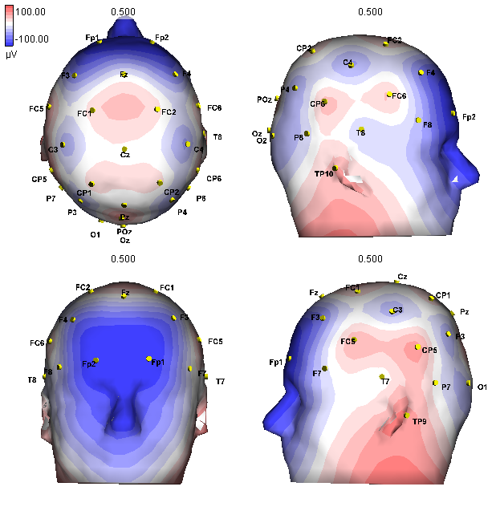
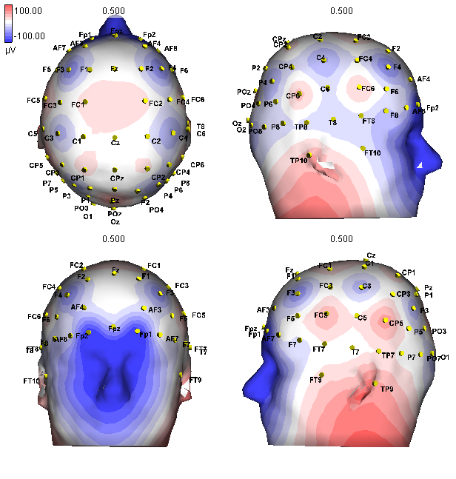
Patient 4, Spike3

Slide 16
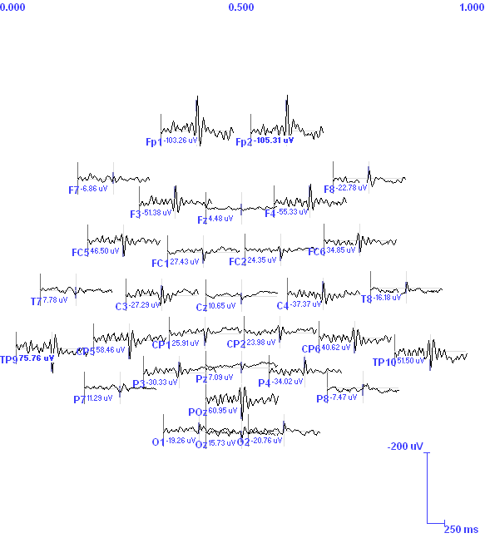
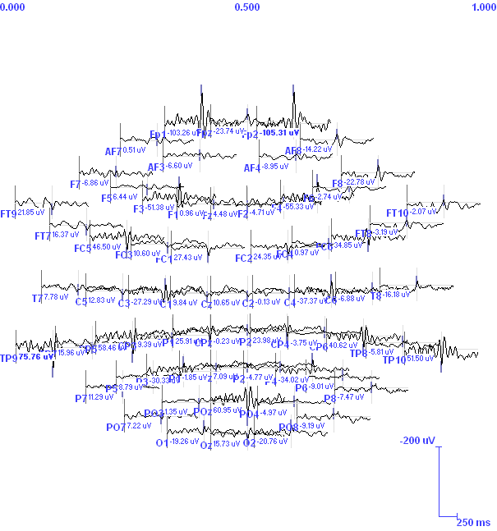

Slide 17
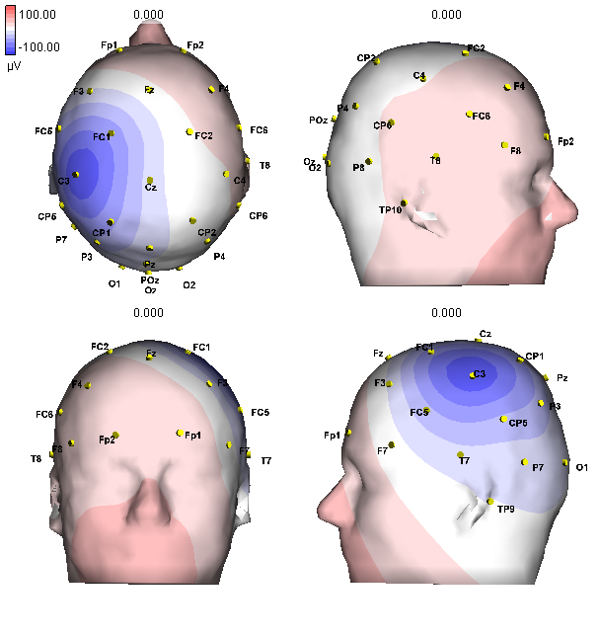
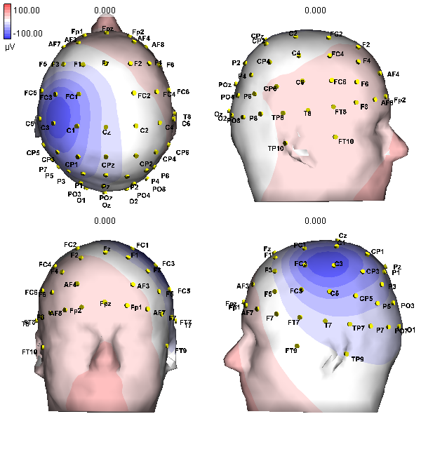
Patient 6, Spike 1

Slide 18
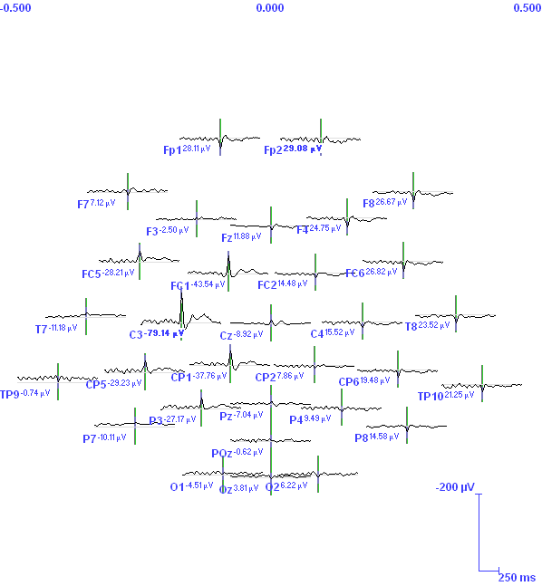
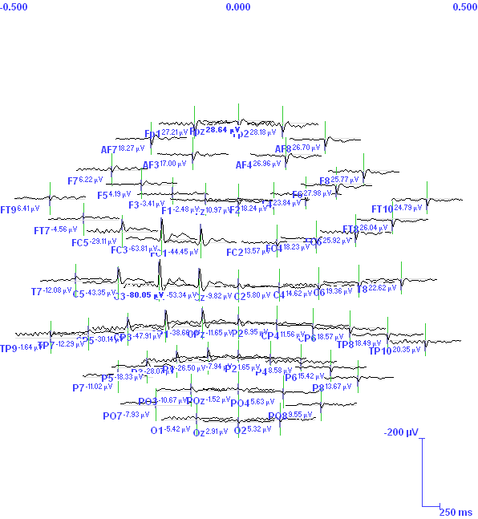

Slide 19
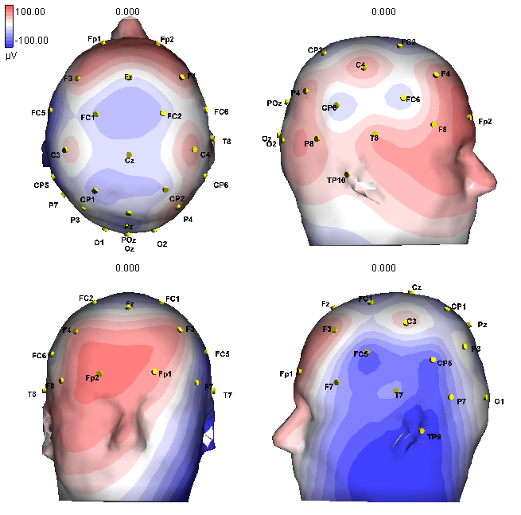
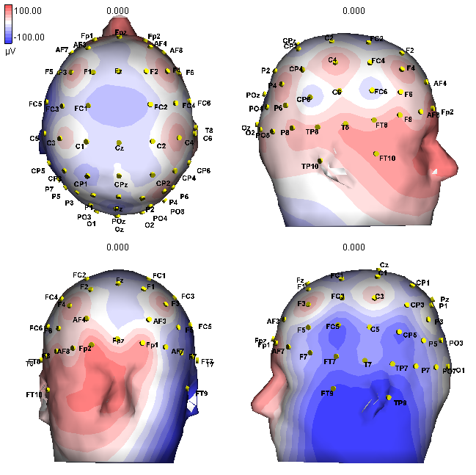
Patient 6, Spike 2

Slide 20
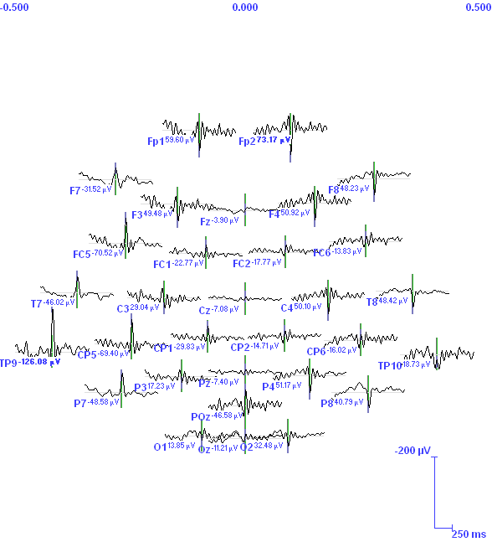
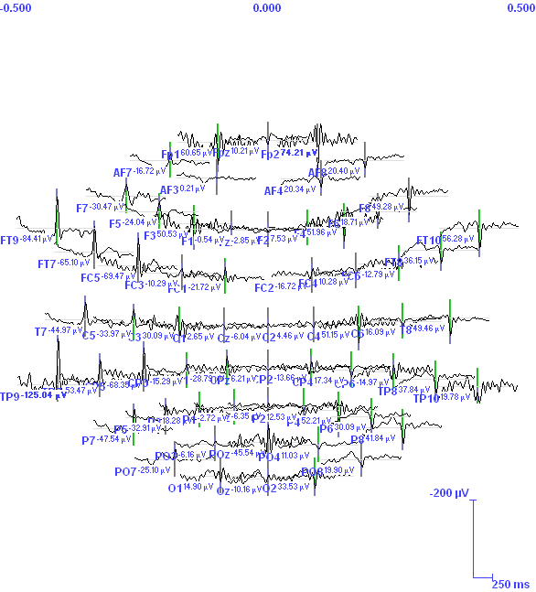

Slide 21
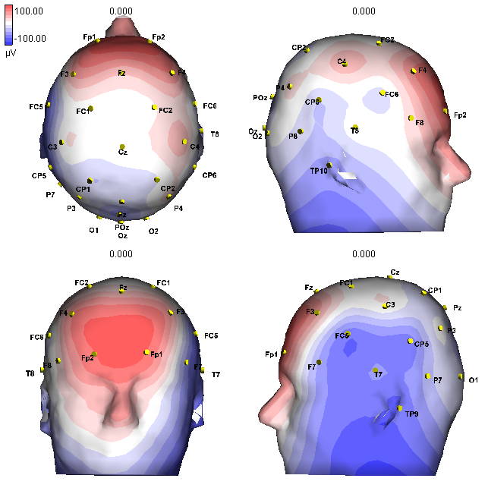
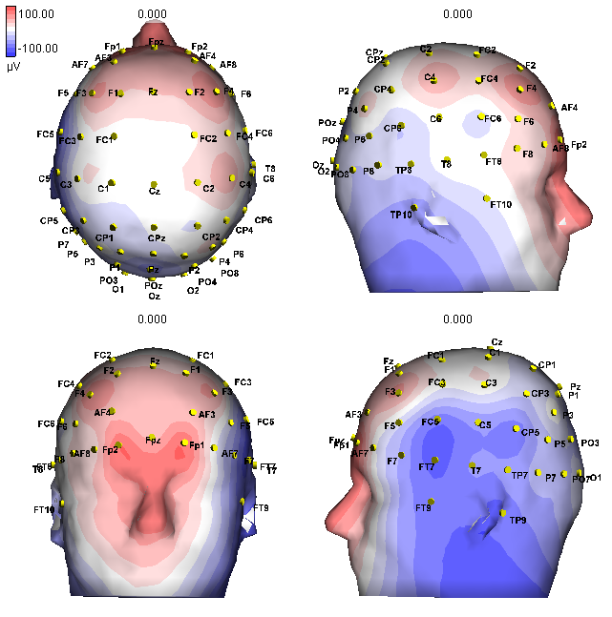
Patient 6, Spike 3

Slide 22
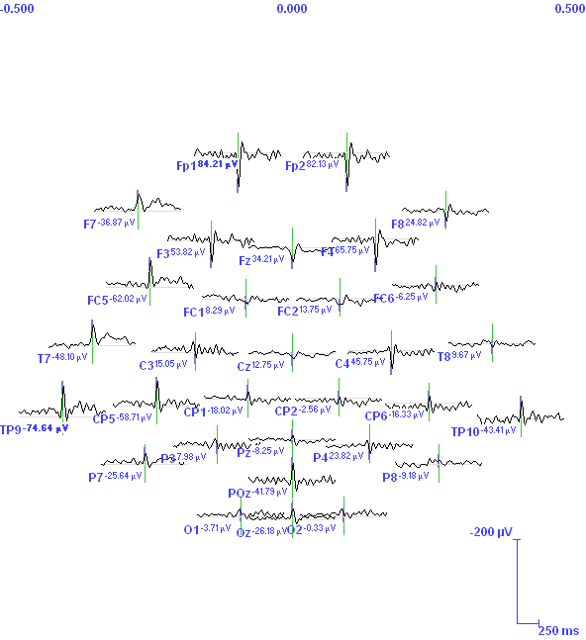
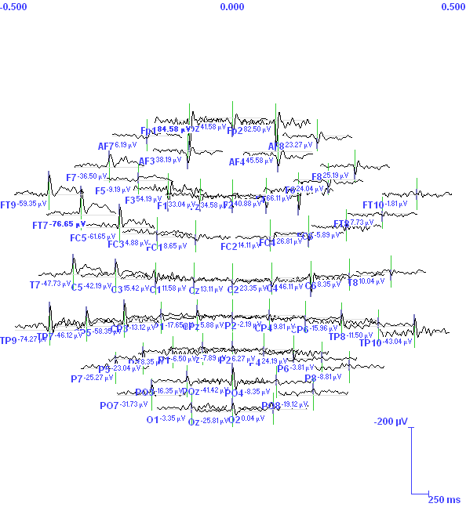

Slide 23
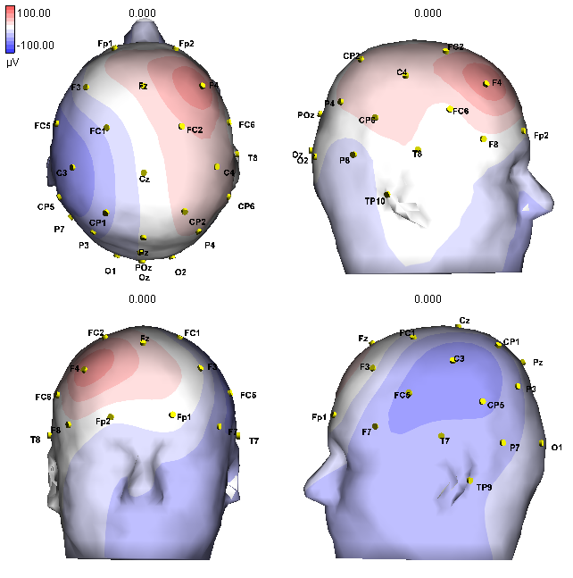
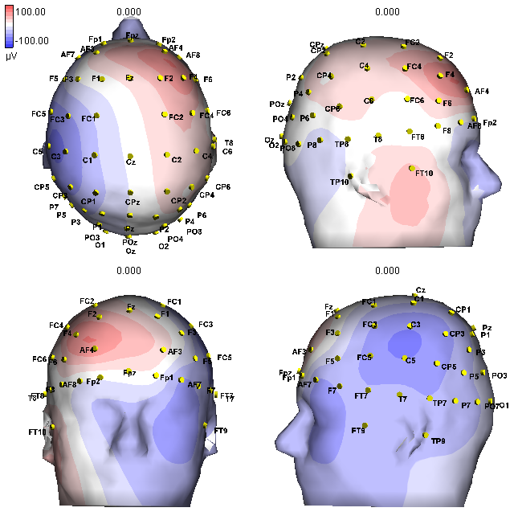
Patient 6, Spike 4

Slide 24
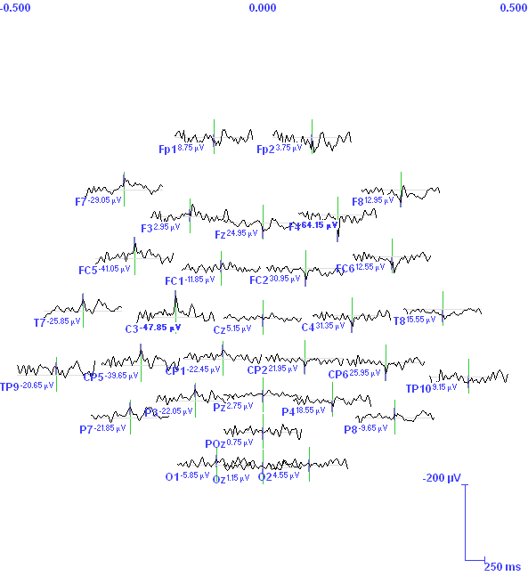
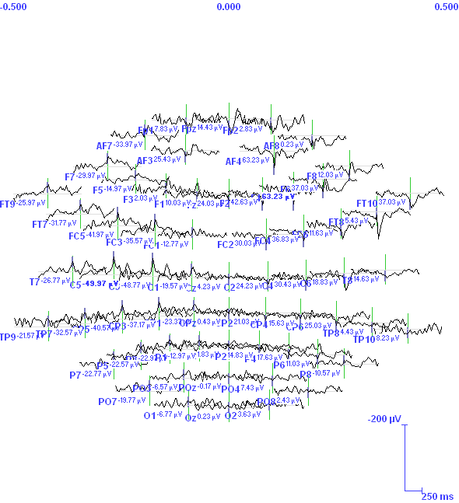

Slide 25
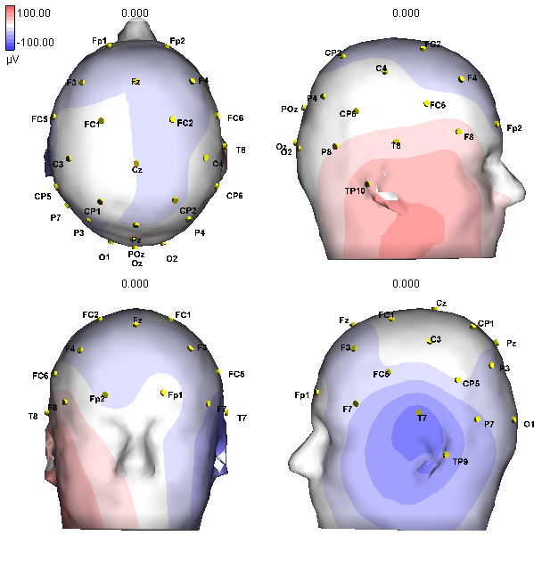
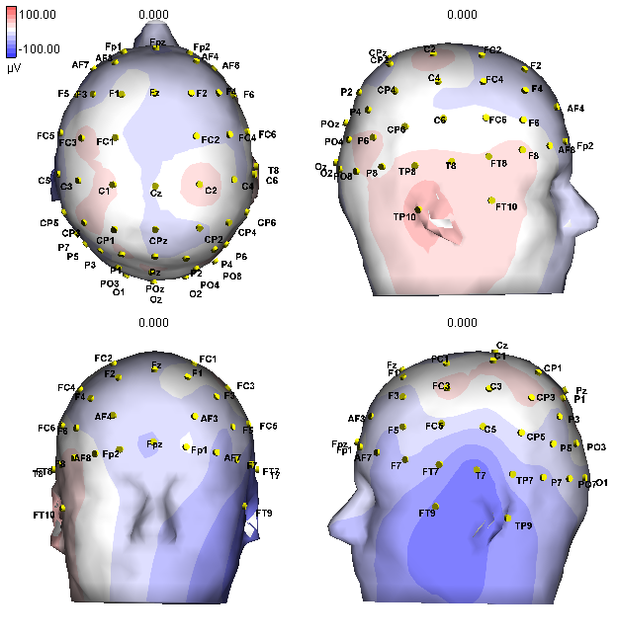
Patient 7, Spike 1

Slide 26



Slide 27


Patient 8, Spike 1

Slide 28



Slide 29


Patient 8, Spike 2

Slide 30



Slide 31


Patient 9, Spike 1

Slide 32



Slide 33


Patient 9, Spike 2

Slide 34



Slide 35


Patient 9, Spike 3

Slide 36



Slide 37


Patient 10, Spike 1

Slide 38



Slide 39


Patient 10, Spike 2

Slide 40



Slide 41


Patient 10, Spike 3

Slide 42



Slide 43


Patient 11, Spike 1

Slide 44



Slide 45


Patient 12, Spike 1

Slide 46



Slide 47


Patient 12, Spike 2

Slide 48



Slide 49


Patient 14, Spike 1

Slide 50



Slide 51


Patient 15, Spike 1

Slide 52



Slide 53


Patient 15, Spike 2

Slide 54



Slide 55


Patient 15, Spike 3

Slide 56



Slide 57


Patient 16, Spike 1

Slide 58



Slide 59


Patient 16, Spike 2

Slide 60



Slide 61


Patient 17, Spike 1

Slide 62



Slide 63


Patient 17, Spike 2

Slide 64



